Slide 1
R: type:
typeof(x)
as.factor(x) factor
as.logical(x) TRUE/FALSE
1/0
Genotypes: ab, Ab, AB
as.factor(x) factor
as.integer(x) integer
1,2,3,-5…
as.numeric(x) double
3.2, 3e-2, 0.03

Slide 2
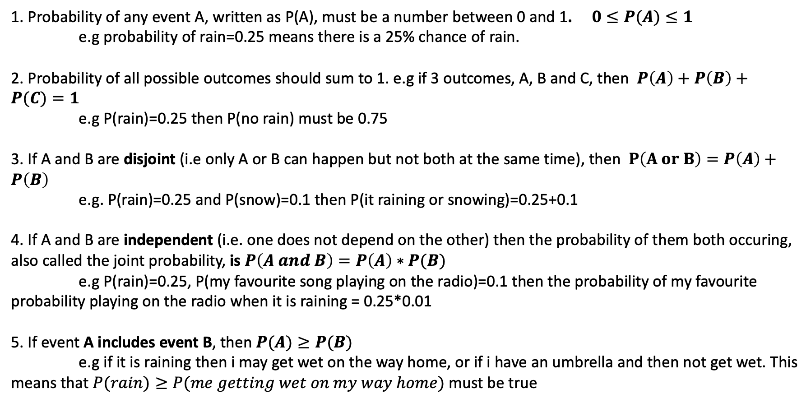
Probability rules
1. Probability of any event A, written as P(A), must be a number between 0 and 1. $0≤P(A)≤1$
e.g probability of rain=0.25 means there is a 25% chance of rain.
2. Probability of all possible outcomes should sum to 1. e.g if 3 outcomes, A, B and C, then $P\left(A\right)+P\left(B\right)+P(C)=1$
e.g P(rain)=0.25 then P(no rain) must be 0.75
3. If A and B are disjoint (i.e only A or B can happen but not both at the same time), then $P\left(A or B\right)=P\left(A\right)+P\left(B\right)$
e.g. P(rain)=0.25 and P(snow)=0.1 then P(it raining or snowing)=0.25+0.1
4. If A and B are independent (i.e. one does not depend on the other) then the probability of them both occuring, also called the joint probability, is $P\left(A and B\right)=P\left(A\right)∗P(B)$
e.g P(rain)=0.25, P(my favourite song playing on the radio)=0.1 then the probability of my favourite probability playing on the radio when it is raining = 0.25*0.01
5. If event A includes event B, then $P(A)≥P(B)$
e.g if it is raining then i may get wet on the way home, or if i have an umbrella and then not get wet. This means that $P(rain)≥P(me getting wet on my way home)$ must be true

Slide 3
PDF: probability density function
CDF: Cumulative distribution function

Slide 4
PDF: probability density function
CDF: Cumulative distribution function
What is probability of getting a value <= 1 (grey area)?
Read off value of CDF at 1 (~0.8)

Slide 5
PDF: probability density function
CDF: Cumulative distribution function
What is probability of getting a value >= 1 (white area)?
Read off value of 1-(CDF at 1) (1-0.8=0.2)

Slide 6
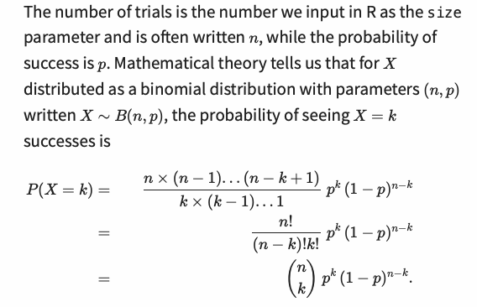
“n factorial” e.g. 3!=3*2*1
“n choose k” is number of ways you can pick 3 successes from n trials

Slide 7
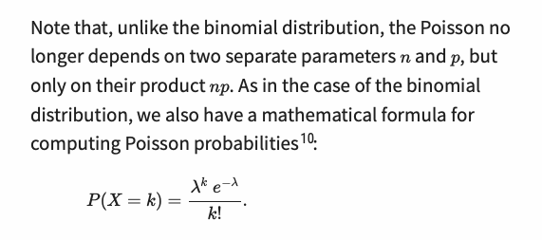
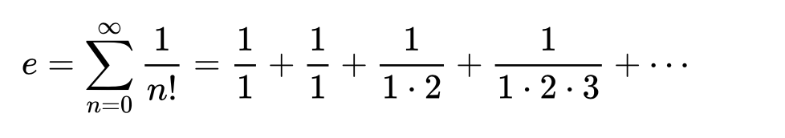
2.71828

Slide 9
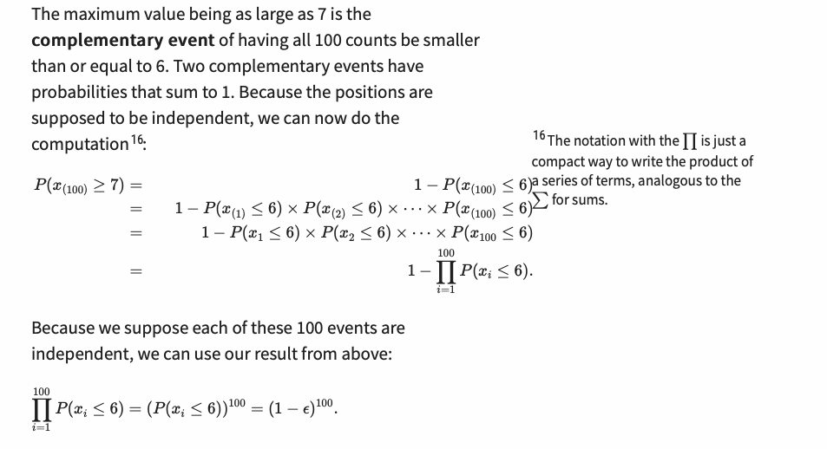

Slide 10
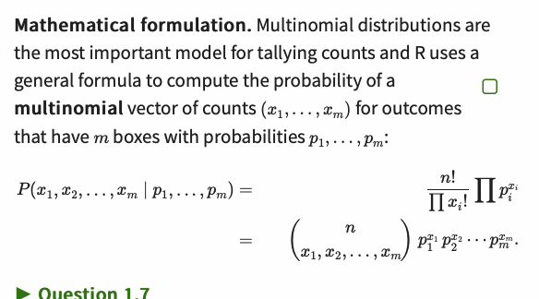

Slide 11
Confusion matrix comparing predictions and ground truth (reality)

